Slide 1



ALFASTACK
PROJECT NAME -:
SCRAP IDENTIFICATION USING DEEP LEARNING

Slide 2

DATASET OVERVIEW
Dataset Overview
Train samples: 2019
Test samples: 508
Classes: cardboard, glass, metal, paper, plastic, trash
Image Details:
Resolution: 224×224 (resized for ResNet input)
Format: JPEG / PNG
Variations include rotation, lighting, and object placement to simulate real-world conveyor conditions.

Slide 3
MODEL OVERVIEW
Model
Base architecture: ResNet18 (pretrained on ImageNet)
Transfer learning applied, last layer fine-tuned
Optimizer: Adam, Loss: CrossEntropy
Device: CPU

Slide 4
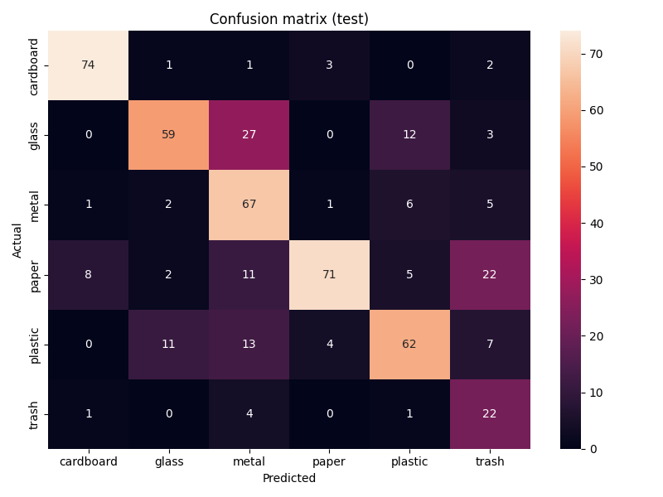
EVALUATION METRICS
Overall Accuracy: 77%
Macro Average F1-score: 0.73
Weighted Average F1-score: 0.77
(Include confusion matrix screenshot for visual)
Key Observations
Best performing classes: cardboard, paper
Lower performance: trash, plastic → may need more data
Transfer learning improved convergence and reduced training time

Slide 5
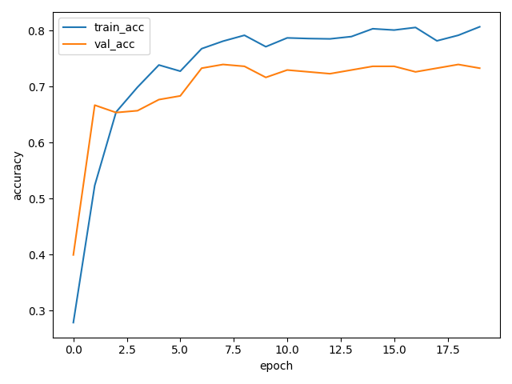
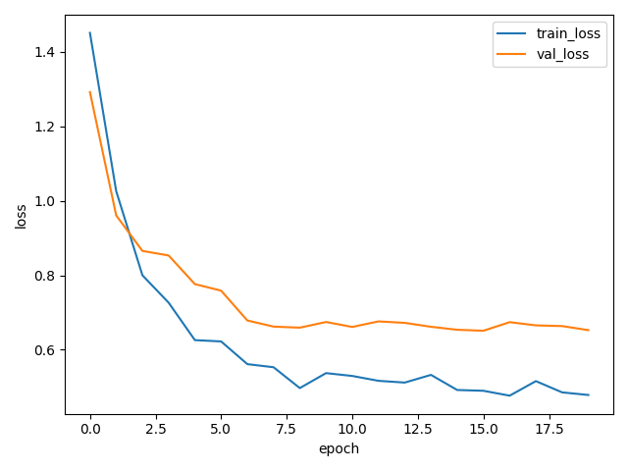
DERIVED PLOTS
Accuracy Curve
Loss Curve

Slide 6
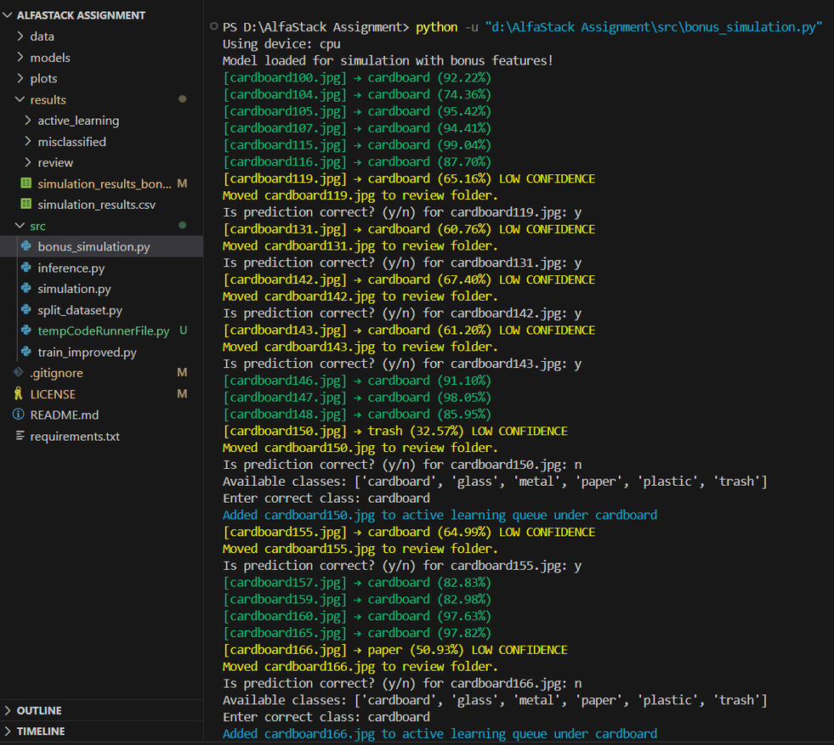
SIMULATION SUMMARY
Real-time Conveyor Simulation:
The trained ResNet18 model was applied to a sequence of images representing scrap items moving on a conveyor belt.
Each image was processed in near real-time to predict the scrap category.
Prediction Confidence & Flags:
Softmax probabilities were used to assign a confidence score to each prediction.
Predictions with confidence below 70% were flagged as “⚠️ Low Confidence” to indicate uncertainty.
This mechanism helps operators or downstream systems take precautionary actions, improving reliability.
Practical Deployment Potential:
Demonstrates feasibility for automation in scrap sorting facilities.
Can be integrated with a physical conveyor system and robotic pickers for real-world applications.
Supports performance monitoring by logging predictions, confidence levels, and misclassifications.
Performance Insights:
High-confidence predictions (>90%) are highly accurate for cardboard, paper, and metal.
Lower confidence observed in visually similar classes like plastic and trash, highlighting areas for further dataset expansion or model refinement.

Slide 7
THANK YOU FOR YOUR TIME AND ATTENTION!
Prepared By-:
Ayush Kumar
prajapatiayush10april2004@gmail.com

